Slide 1

The First 90 Days in a New Role
How to Make Them Count

Slide 2
AGENDA
01
02
03
04
Framework
Action Plan
Understanding the 30-60-90-day approach
What to do in each phase
Mistakes To Avoid
What Drives Success
Common Onboaring traps
Value, trust, and growth

Slide 3
Why the First 90 Days Matter
First Impressions
Learning Curve
Career Impact
60% of managers say they decide a new hire’s long-term potential within the first 3 months.
The first 90 days are when employees learn the fastest -understanding tools, teams, and expectations.
A strong start builds trust early and leads to faster growth, better opportunities, and more responsibility.

Slide 4
The 30–60–90 Day Framework
0-30 Days
31-60 Days
61-90 Days
Learn
Contribute
Own
Understand company, tools, and team
Observe workflows and ask questions
Start working on tasks
Collaborate and apply learning
Take ownership of work
Deliver results independently

Slide 5

First 30 Days: Learn
Understand tools, workflows, and team structure
Observe how tasks move from idea → development → deployment
Ask questions and clarify expectations early

Slide 6

31–60 Days: Contribute
Getting Started
Work on small tasks
Apply what youm lerned in real scenarios
Build confidence through hand-on work
Working with the team
Collaborate with teammates on task
Ask for feedback and improve
Participate in discussions and meetings

Slide 7
61–90 Days: Own
Take Ownership
Handle tasks independently
Take responsibility for outcomes
Drive Improvements
Think beyond assigned tasks
Suggest better solutions or improvements
Deliver Results
Complete tasks end-to-end
Build trust within the team

Slide 8
⚠️ Common Mistakes to Avoid
Sticking only to what you already know
Trying to do too much too fast
Setting unrealistic expectations
These are common traps highlighted in professional frameworks like “The First 90 Days” by Michael D. Watkins.

Slide 9

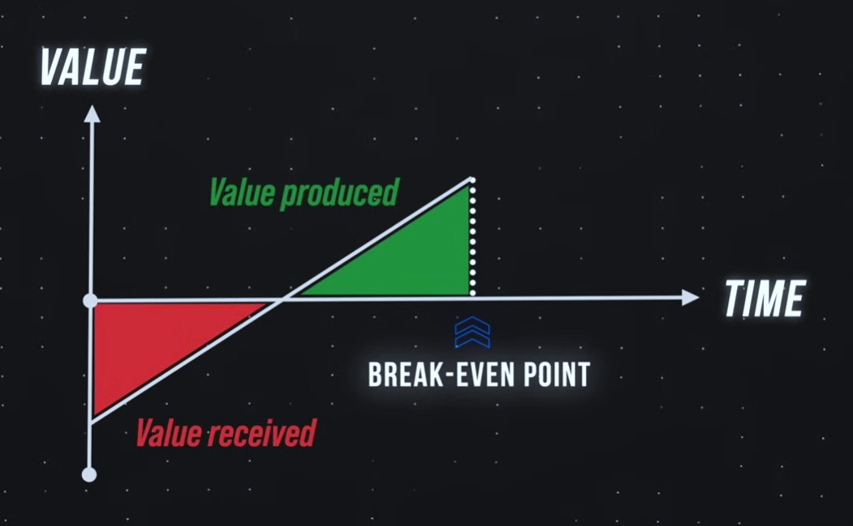
The faster you create value, the faster you earn trust.
Your Goal in the First 90 days

Slide 10
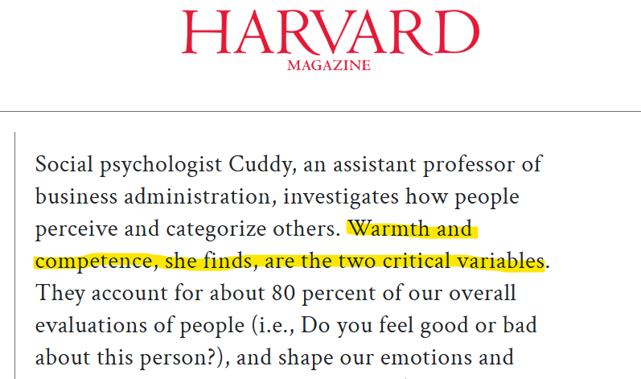
What Determines Your Success
Align with team values
Show the right attitude and energy
Demonstrate competence in your work
People decide who to trust before they decide who is skilled.
Source: Harvard Business Review

Slide 11
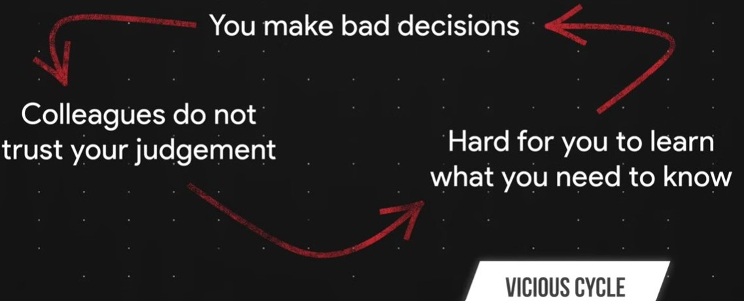
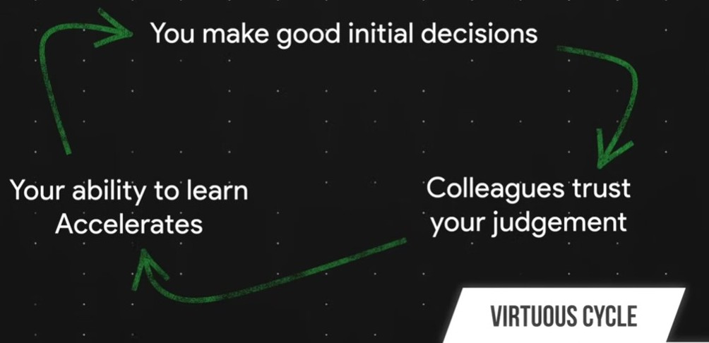
Two Possible Paths in Your First 90 Days
Your early actions don’t just affect results- they shape your entire growth path.

Slide 12
Key Takeaways
Learn → Contribute → Own
Avoid common onboarding mistakes
Focus on creating value early
Build trust through your actions
Your first 90 days don’t define your job - they define your trajectory.

Slide 13
THANK YOU
Your first 90 days don’t define your job—they define your trajectory.
Questions?

